Slide 1

Sprocket Central Pty Ltd
Data analytics approach
[Division Name] - [Engagement Manager], [Senior Consultant], [Junior Consultant]

Slide 2
Agenda
Introduction
Data Exploration
Model Development
Interpretation

Slide 3

Introduction
Hey,Sprocket Centeral Pty Ltd
Thanks for giving us this chance to work with the marketing team. We are doing our best to analyze this dataset so you can improve performance by focusing on high values customers .
We hope this information is useful for you and will let us make more great work together in the future .

Slide 4
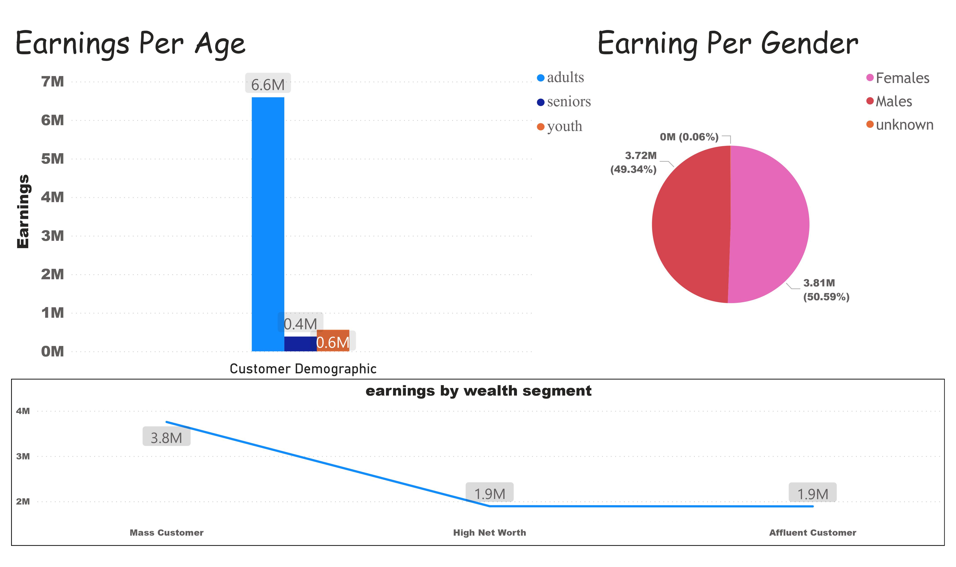
Data Exploration

Slide 5
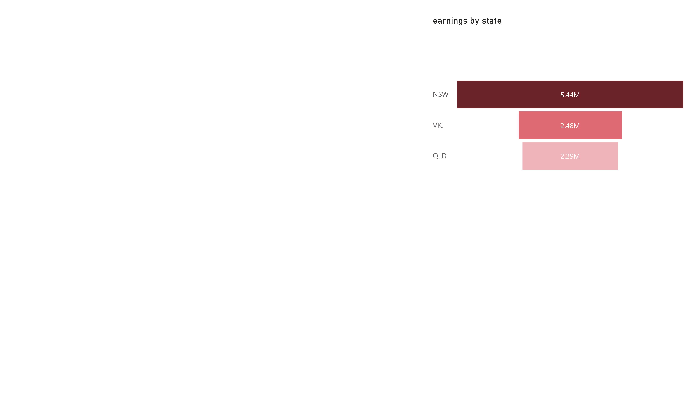
Customer Segments we used :
Age
Gender
Location
Wealth segment
As we see in the first dashboard:
1-Adult age (25:64) is the biggest bar
In our analyzed data
2- Females gender have the highest
earnings in the pie chart with percentage
Of 50.59% and total earnigns 3.81 M $ next to it men with 49.34%
And 3.72 as total earnings
3-mass customer total earnings 3.8 M $ other wise the High net and Affluent
Whose total earnings equal 1.9 M $

Slide 6
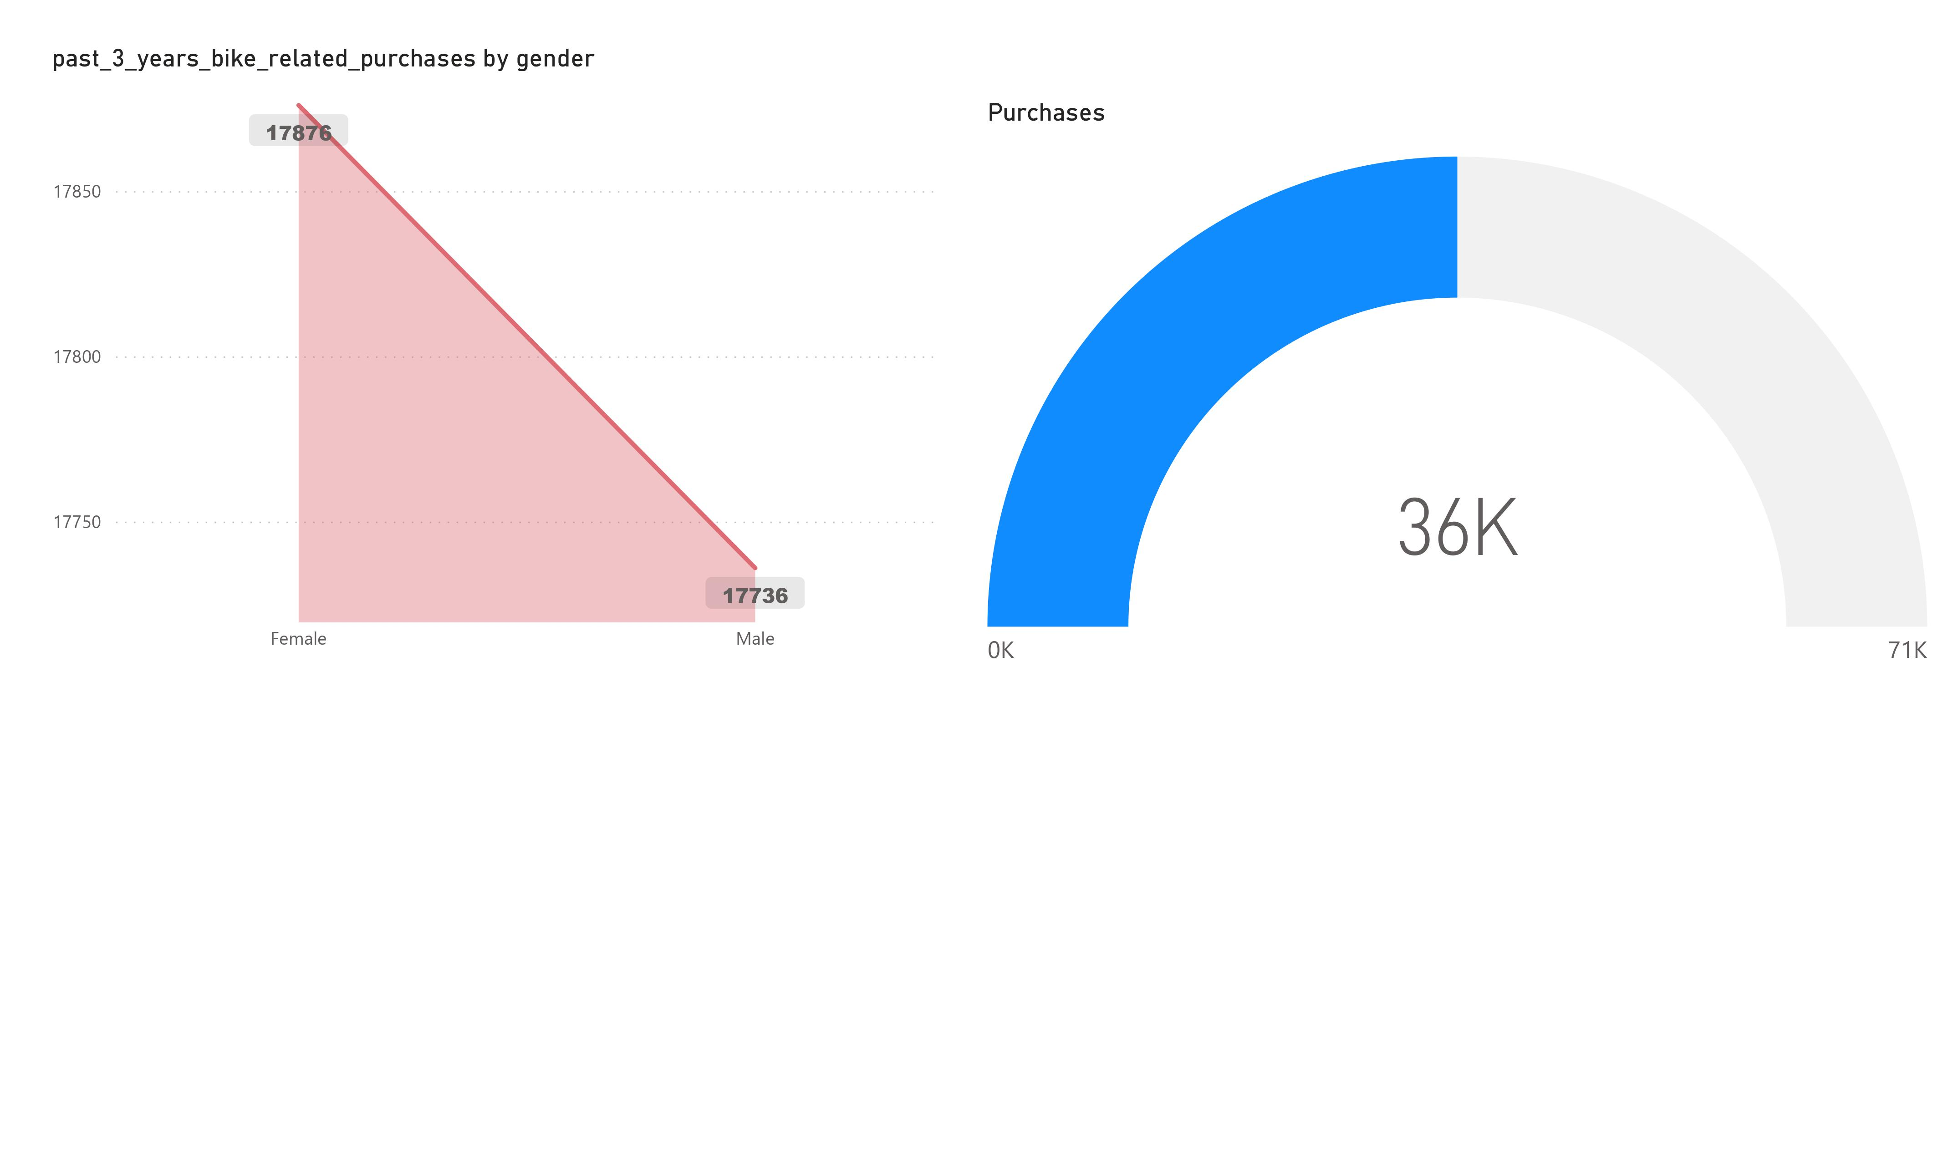
Model Development
Female new clients has total pays of 17876 items which make us sure that
The analyze was correct

Slide 7
Interpretation
1- We have to focus on female mass customers more than men
2-The advertisements will locate adult (25:64)
Our mission will be :
Analyzing the data of New Customers and grab all the customers with these
Specification
separate males,females and unknown genders and
Add age column
At last we were glad to work with you hope that our work is satisfying enough
KPMG Team

Slide 8
Appendix

